Slide 1
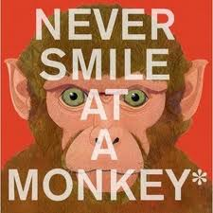
Text Talk
Westside Elementary

Slide 2
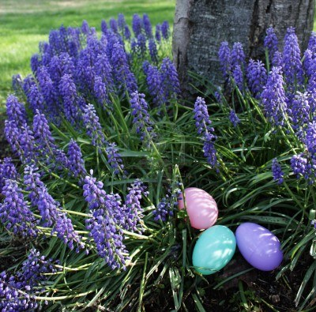
The word obvious means easy to see or understand.
It was obvious that she was ill.
Use the word obvious to explain this picture.

Slide 3
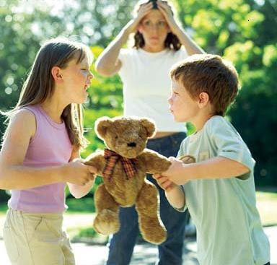
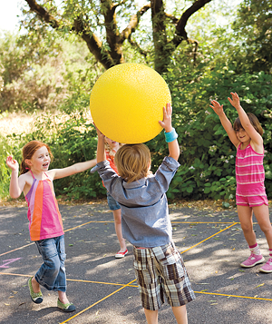
The word harass means to criticize or attack.
It is not nice to harass other people.
Which picture shows harass? Explain why you think the picture goes with harass?

Slide 4
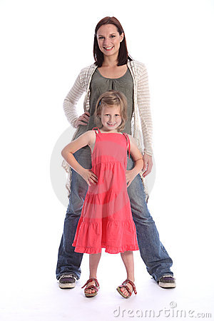
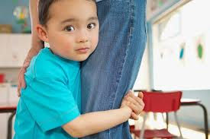
The word clutch means to grasp or hold tightly with your hand.
He had a book clutched in his hand.
Which picture goes with clutch? Explain why it goes with the word clutch?

